Slide 1
Pixel Band
Clumsy Guppy Studios Present:
Diana Kumykova + Isabelle Cordova

Slide 2
Pixel Band enables the novice player to become a digital composer who orchestrates pixelated instruments into symphonic masterpieces
Logline

Slide 3
Essential Features
With Pixel Band, the player is able to...
Compose simple tunes
Arrange a variety of different instruments
Experience visual feedback of what instruments are playing
Employ basic looping features to automate their composition

Slide 4
Activity Description
The Pixel Band toy concept is a response to overly-complicated composition programs such as Garage Band that aims to give its players a fun way to play around with different instrument sounds and create simple melodies by utilizing rudimentary looping features.

Slide 5
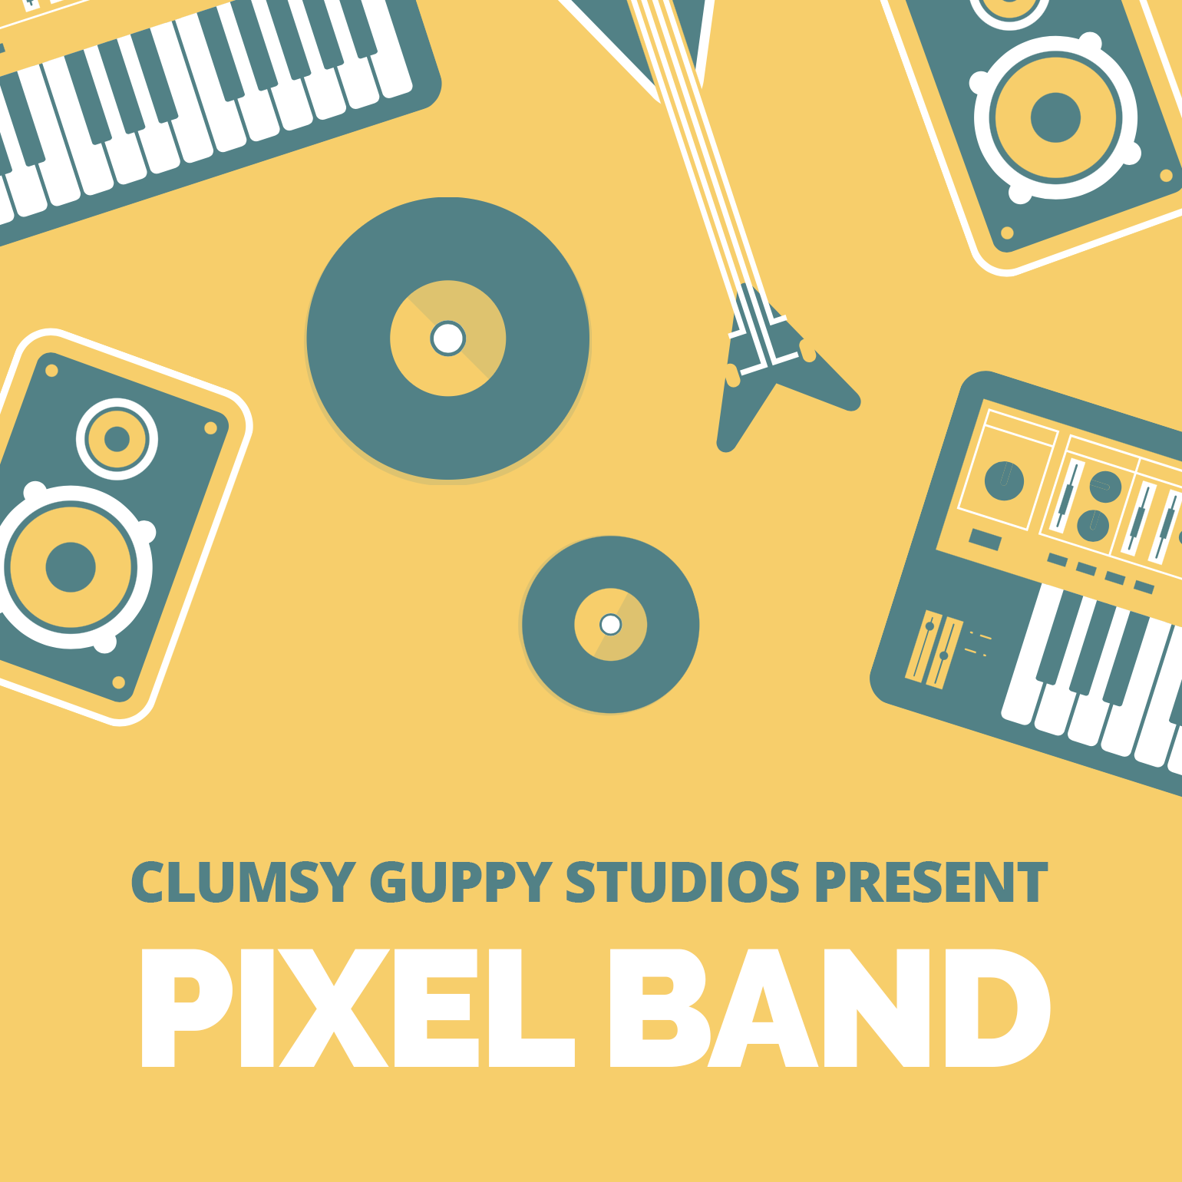
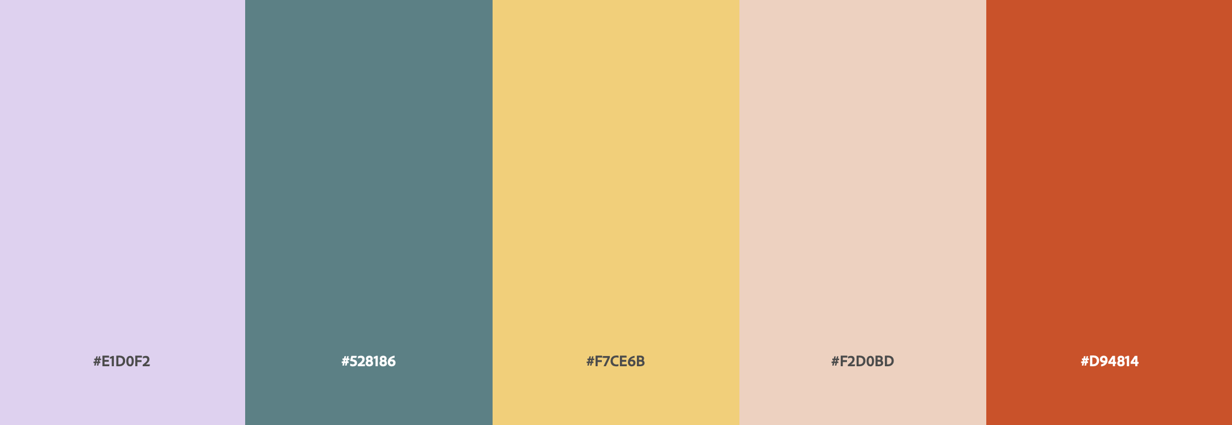
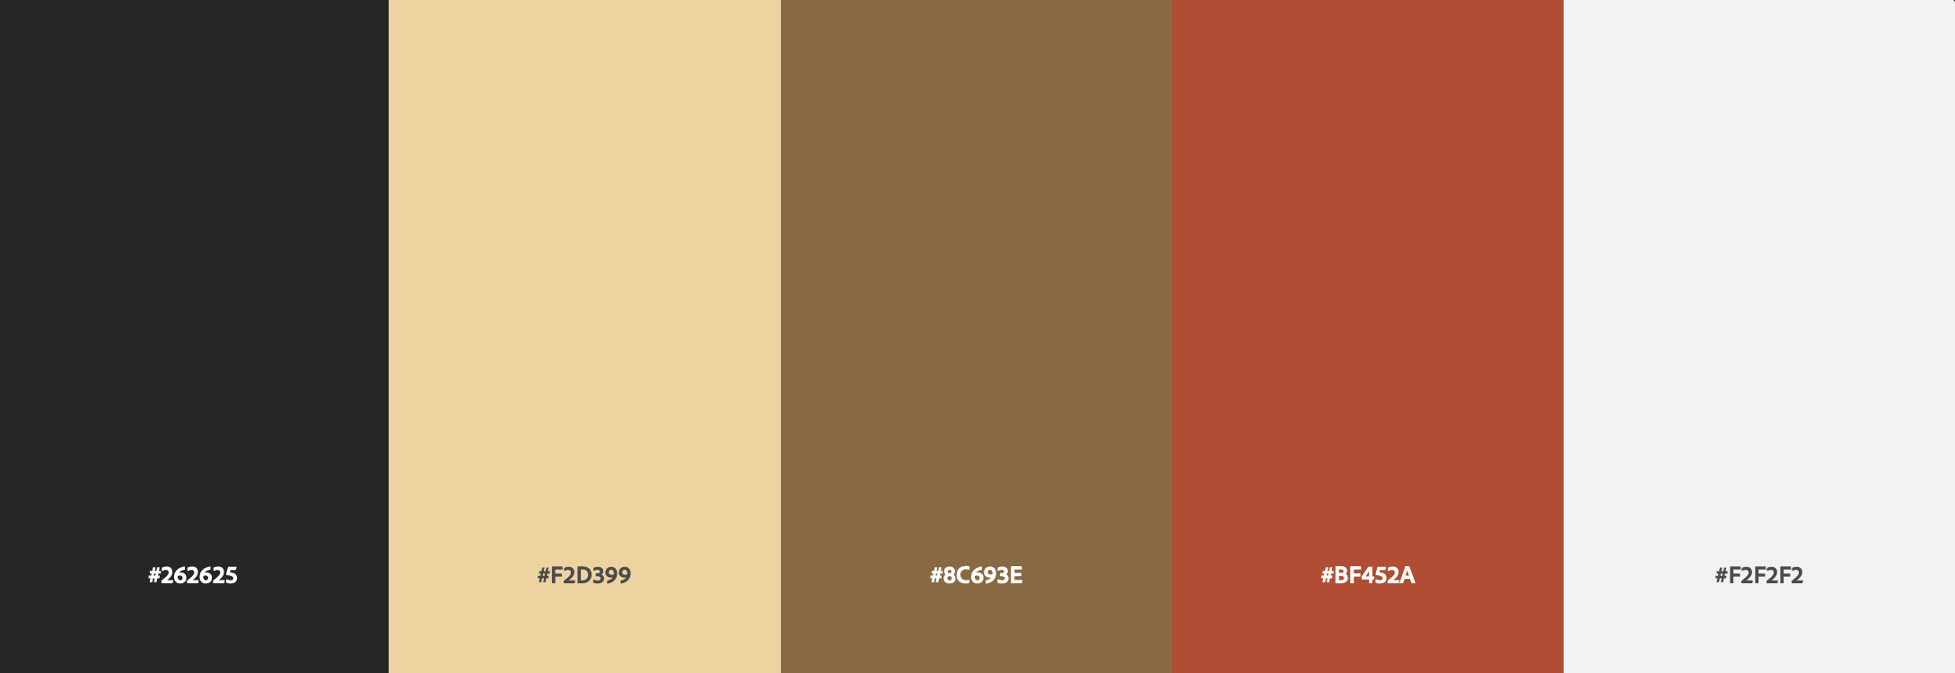
Design Mockups, pt. 1
Splash Image
Tentative Color Scheme

Slide 6

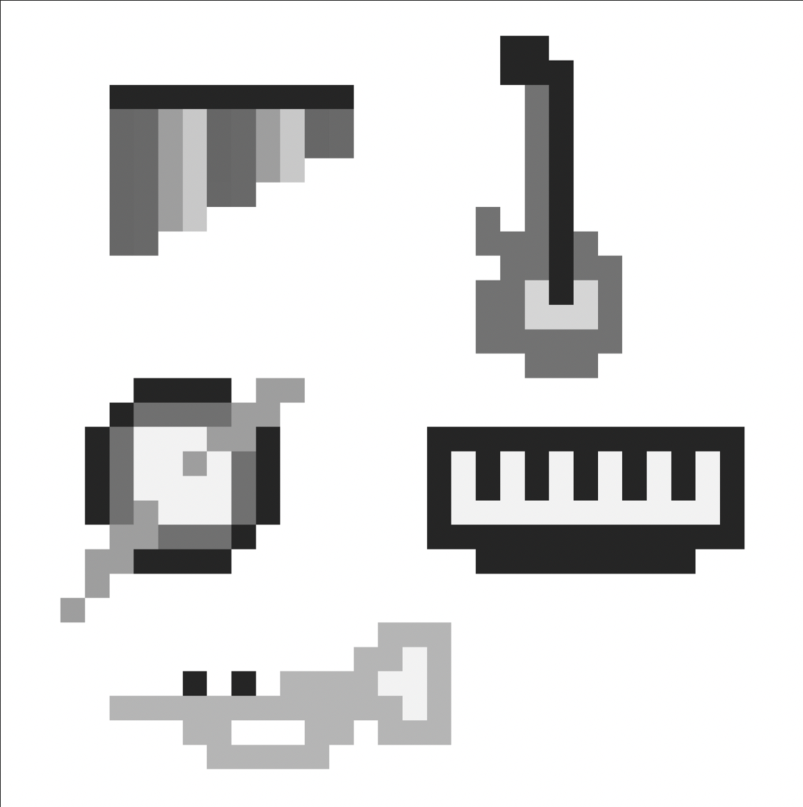
Design Mockups, pt. 2
Instrument Ideation - active state
Instrument Ideation - inactive state

Slide 7
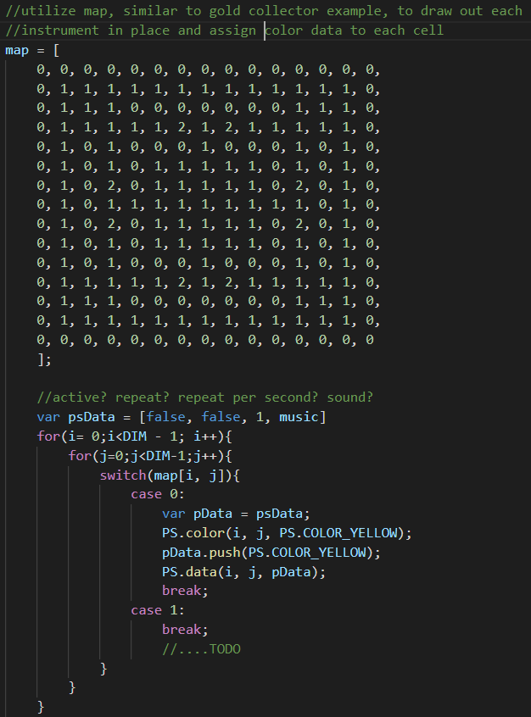
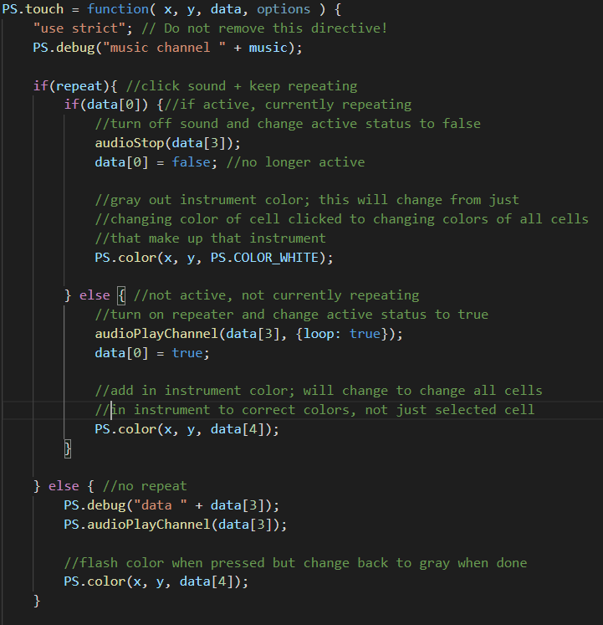
Demo Code
Tentative idea for drawing instruments onto grid and enabling easy color toggling for each one
Preliminary repeater code - can currently toggle on/off note repetition, aiming to add in tempo options as well

